Slide 1
CH-105 INORGANIC TUTORIAL -III
Topic-IV
Q-IV.1. Calculate the ground state Term symbols for the following ions.
a) Ni²⁺ b) Dy³⁺ c) Ti²⁺ d) C
Ans.
For Ni²⁺
[Ar] 3d⁸
+2 +1 0 -1 -2
S = 1/2, -1/2, 1/2, -1/2, 1/2, -1/2, 1/2, 1/2
J = L + S ,........, |L - S|
= 3 + 1,........., 3 - 1
= 4, 3, 2
M_{L} = 2 + 2 + 1 + 1 + 0 - 1 -2 = 3
2S+1 = 2 *1 + 1 = 3 Where S = 1
Since d orbital is more than half field, So highest value of J will give the ground state term. Hence ground state term symbol is ³F₄

Slide 2
CH-105 INORGANIC TUTORIAL -III
Topic-IV
Ans.
For Dy³⁺
[Xe] 4f⁹
+3 +2 +1 0 -1 -2 -3
S = 1/2, -1/2, 1/2, -1/2, 1/2, 1/2, 1/2, 1/2, 1/2 = 5/2
M_{L} = 3 + 3 + 2 + 2 + 1 + 0 - 1 -2 - 3 = 5
J = L + S ,........, |L - S|
= 5 +5/2,........., 5 - 5/2
= 15/2, .........., 5/2
2S+1 = 2 *5/2 + 1 = 6 Where S = 5/2
Since f orbital is more than half field, So highest value of J will give the ground state term. Hence ground state term symbol is ⁶H_{15/2}

Slide 3
CH-105 INORGANIC TUTORIAL -III
Topic-IV
For Ti²⁺
[Ar] 3d²
For C
2S², 2P²
+2 +1 0 -1 -2
0 +1 0 -1
S = 1/2 + 1/2 = 1
S = 1/2 + 1/2 = 1
M_{L} = 2 + 1 = 3
M_{L} = 1 = 1
2S+1 = 2 *1 + 1 = 3 Where S = 1
2S+1 = 2 *1 + 1 = 3
J = L + S ,........, |L - S|
= 3 + 1,........., 3 - 1
= 4, 3, 2
J = L + S ,........, |L - S|
= 1 + 1,........., 1- 1
= 2, 1, 0
Since d orbital is less than half field, So lowest value of J will give the ground state term. Hence ground state term symbol is ³F₂
Since p orbital is less than half field, So lowest value of J will give the ground state term. Hence ground state term symbol is ³P₀

Slide 4
CH-105 INORGANIC TUTORIAL -III
Topic-IV
Q-IV.2. The following complexes have the indicated effective magnetic moments. Describe the structure and bonding of the complexes on the basis of the µ_{eff} values (in B.M.).
μ_{so} = √n (n +2) B.M.
(a) K₂NiF₆ (0.0) = Nickel is in +4 Oxidation hence low spin S = 0.
(b) Ni(NH₃)₂Cl₂ (3.3)
Ammonia is a strong field ligand hence tetrahedral geometry is not possible and square planar complex will give S = 0. This suggests that this complex likely to be octahedral and the geometry is
(c) Ni(PEt₃)₂Cl₂ (0.0) Square planar and S = 0
(d) Ni(Ph₃AsO)₂Cl₂ (3.95) Tetrahedral and ground state orbital angular momentum hence large mag moment.

Slide 5
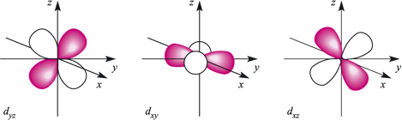
CH-105 INORGANIC TUTORIAL -III
Topic-IV
Q-IV.3. Identify the transition metal configurations both in the octahedral and tetrahedral environments which are expected to have an orbital contribution to the magnetic moment.
The degenerate t2g orbitals (dxy, dxz, dyz) can be interconverted by 90° rotations.
e.g. the dxz orbital is transformed into the dyz orbital by a rotation of 90° about the z-axis – during this rotation the electron is orbiting the nucleus
x
y
Thus, an electron in a t₂g orbital can contribute to orbital angular momentum.

Slide 6
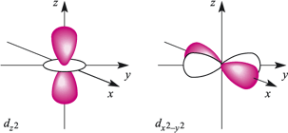
CH-105 INORGANIC TUTORIAL -III
Topic-IV
The eg orbitals (dz² and dx²-y²) cannot be interconverted by rotation as they are different in shapes
Thus an electron in an eg orbital can not contribute to orbital angular momentum.
Octahedral (high spin) | Octahedral (low spin) | Tetrahedral
a) Fe³⁺ (No) | a) Fe³⁺ = (Yes) | a) Cr³⁺ = (Yes)
b) Fe²⁺ (Yes) | b) Fe²⁺ = (NA; S = 0) | b) Fe³⁺ = (No)
c) Ni²⁺ (No) | c) Co²⁺ = (No) | c) Mn³⁺ = (Yes)
d) Ti³⁺ (Yes) | d) Cr²⁺ = (Yes) | d) Fe²⁺ = (No)
e) Sc³⁺ (NA; S = 0) | e) Zn²⁺ = (NA; S = 0) | e) Pt²⁺ = (NA; S = 0)

Slide 7
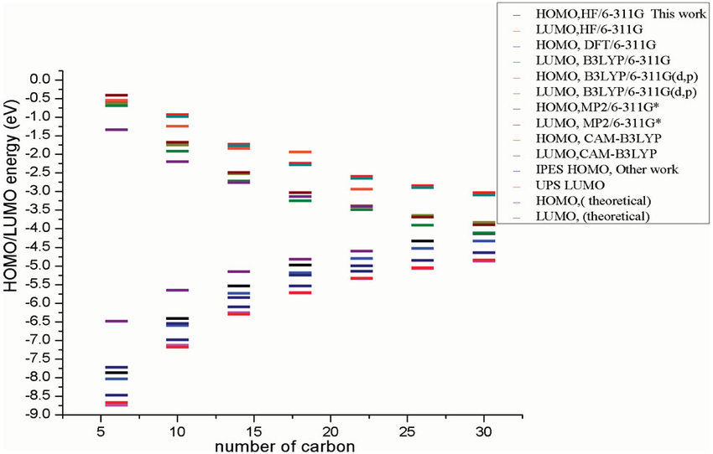
CH-105 INORGANIC TUTORIAL -III
Topic-IV
Q-IV.4. Which one would you expect to have a greater magnetic moment: CoCl₄²⁻ or CoI₄²⁻? Why?
μ _{eff} = μ_{s.o.} [ 1- α λ / Δ]
F⁻
Br⁻
Cl⁻
I⁻
where λ is positive for d¹, d², d³, d⁴
negative for d⁶, d⁷, d⁸, d⁹
α = 2 for ²D and ⁵D , 4 for ³F and ⁴F and 0 for ⁶S
At⁻
[CoI₄]²⁻, because the first excited state is expected to be closer to the ground state compared to [CoCl₄]²⁻. Hence, the orbital contribution arising from the excited state of [CoI₄]²⁻ is larger than the same in [CoCl₄]²⁻.

Slide 8
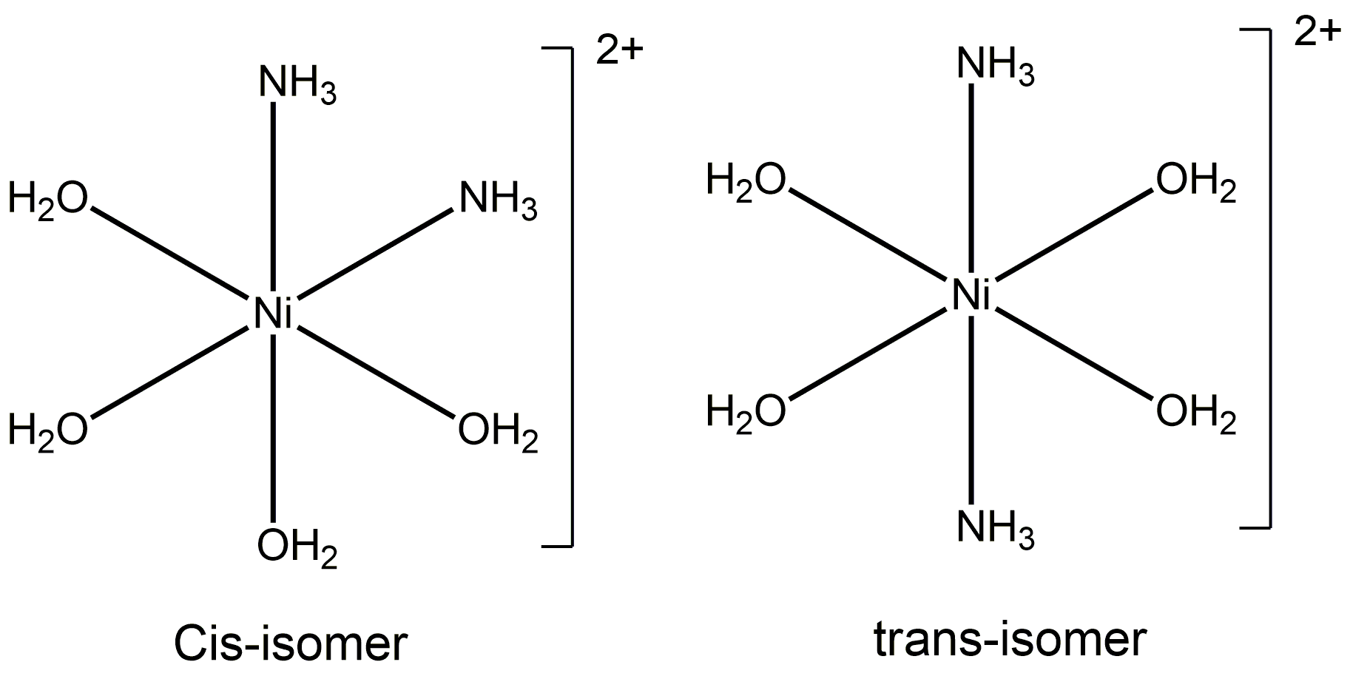
CH-105 INORGANIC TUTORIAL -III
Topic-IV
Q-IV.5. ‘Y’ is a complex of nickel possessing water and ammonia as ligands, but not in equal in number. Complex ‘Y’ upon treatment with AgNO₃ gives two equivalents of AgCl; it gives a measured magnetic moment of 2.9 BM. Give the formula of the complex and draw its both the isomeric structures.
[Ni(H₂O)₄(NH₃)₂]Cl₂ or [Ni(H₂O)₂(NH₃)₄]Cl₂

Slide 9
CH-105 INORGANIC TUTORIAL -III
Topic-IV
i) It is given that the complex Y gives two equivalent of AgCl upon reaction with AgNO₃. Hence this suggests that there are two chloride ligand is outside the coordination sphere.
ii) Since the water and ammonia ligands are neutral and two halides outside the coordination sphere implies that the metal oxidation state should be +2.
iii) Complex Y shows mag. Moment value of 2.9 BM corresponds to an octahedral (spin only value) complex.
iv) As it is stated, water and NH₃ should not be equal in number, the only combination which will give octahedral complex, at the same time which will have two isomer formation for the proposed formula.

Slide 10
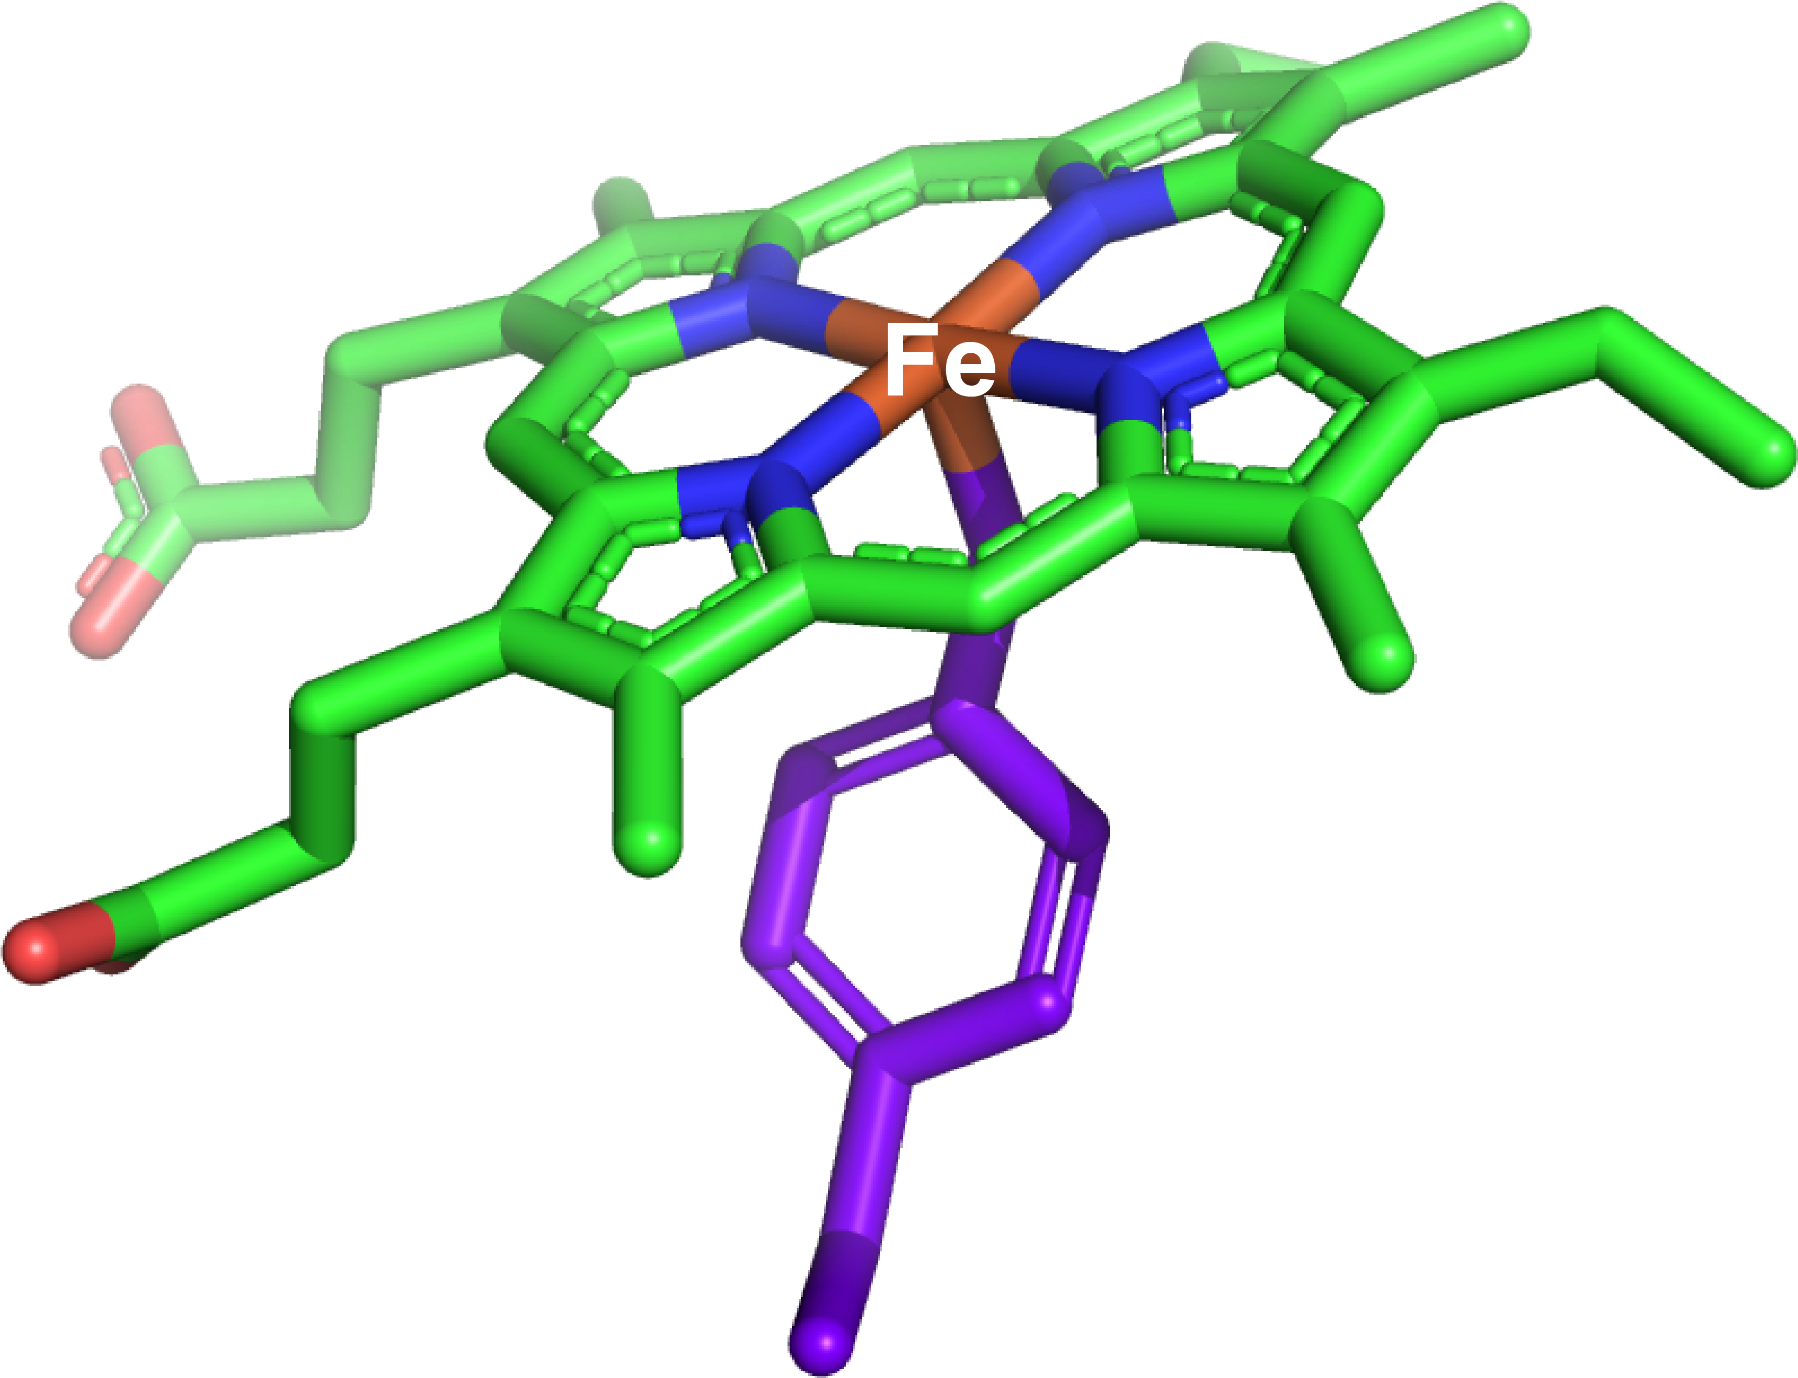
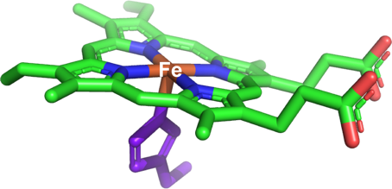
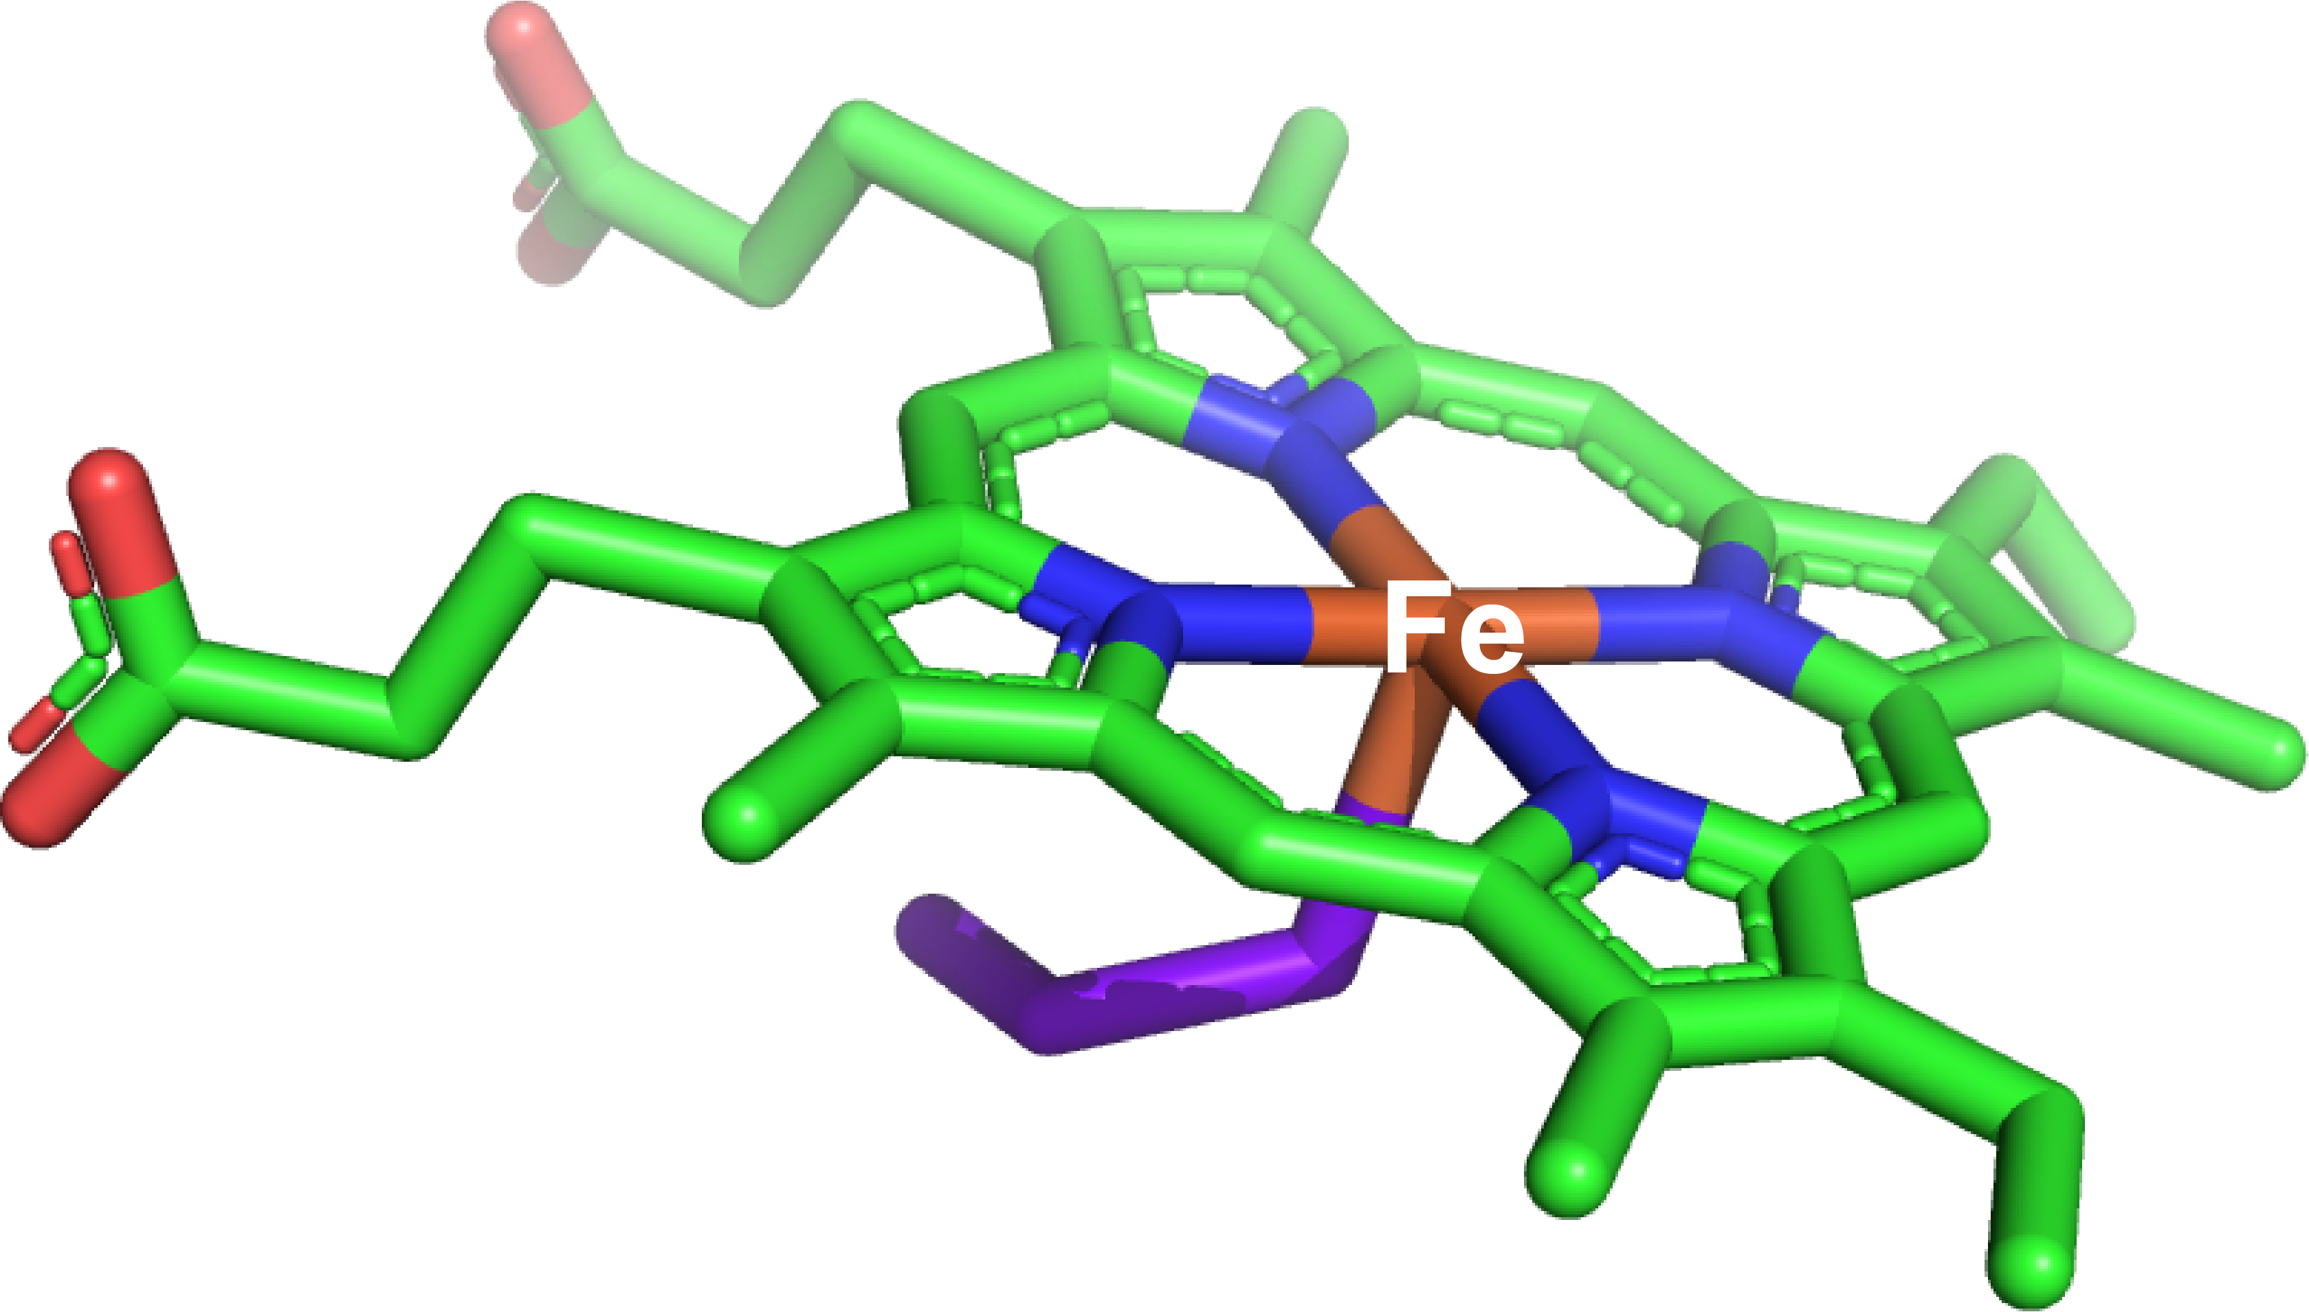
CH-105 INORGANIC TUTORIAL -III
Topic-V
Q-V.1.The principal difference observed in the metal active site of catalase, peroxidase, and cytochrome P-450 enzymes are the identity of the axial ligand (tyrosine, histidine, and cysteine, respectively, as shown in the figure below). How the axial ligand→ Fe(heme) σ-donation property varies for these three enzymes active sites?
2H₂O₂
H₂O₂
O₂
Sub(red)
Sub(red)
Sub(ox)
Sub(ox)
2H₂O + O₂
H₂O
H₂O
Catalase
Tyrosine axial ligand
Peroxidase
Histidine axial ligand
Cytochrome P-450
Cysteine axial ligand
The axial ligand→ Fe(heme) σ-donation propensity follows the following trend:
S(cysteine) → Fe(heme) > O(tyrosine) → Fe(heme) > N(histidine) → Fe(heme)
The σ-donation is strongest for the thiolate group present in cysteine due to the involvement of S(3p) orbitals that has significant overlap with Fe(d)-orbitals. Among the rest, the tyrosinate (Ph-O⁻) pushes its electron density strongly towards heme Fe compared to N (histidine) due to the presence of negative charge (N-histidine is neutral here).

Slide 11
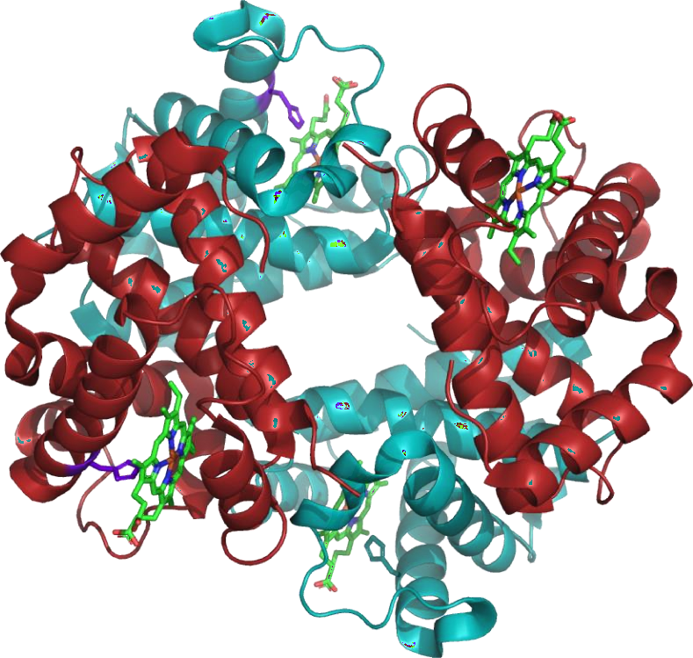
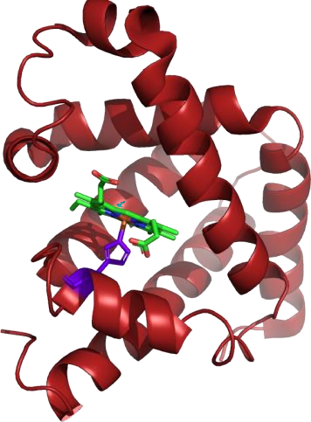
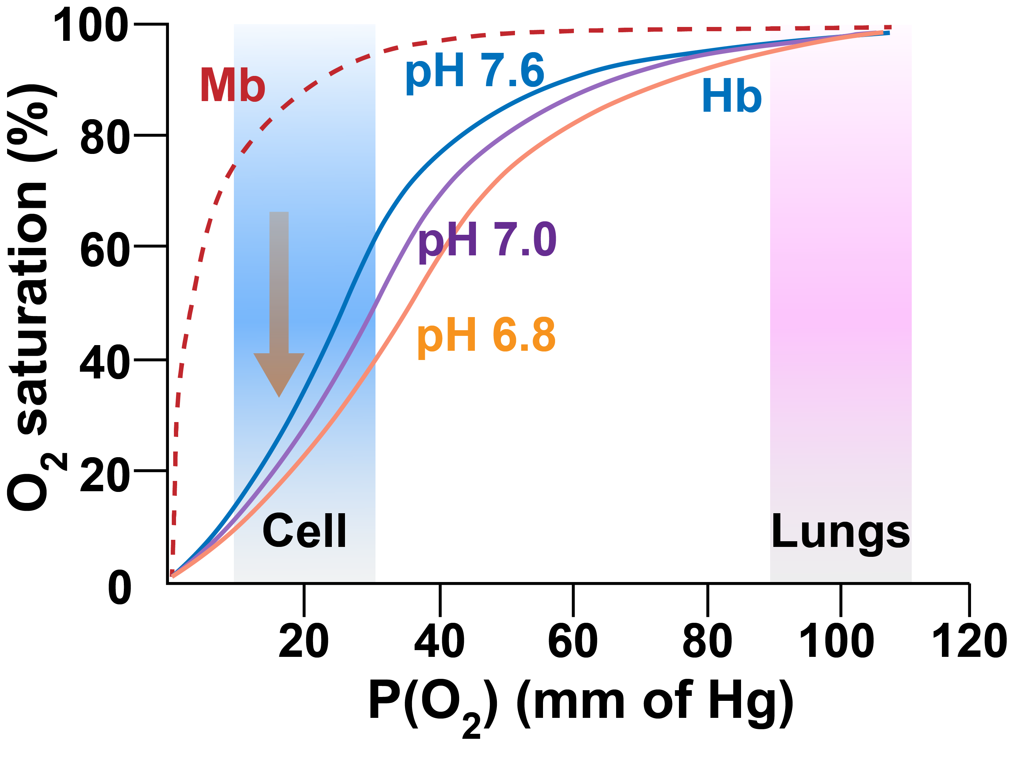
CH-105 INORGANIC TUTORIAL -III
Topic-V
Q-V.2. Following is the O₂-binding curve for Hemoglobin (Hb) at pH 6.8, 7.0, and 7.6 along with Myoglobin. If a cell is started to getting saturated with CO₂, what will be the response from Hb and Mb?
Hemoglobin (Hb)
α₂β₂ hetero-tetrameric structure
Monomeric structure
The O₂-binding ability for Hb decreases at lower conc. of O₂ with increasing acidity

Slide 12
CH-105 INORGANIC TUTORIAL -III
Topic-V
Bohr effect
C₆H₁₂O₆ + 6O₂ → CO₂ + H₂O + energy (ATP)
↓H₂O
H₂CO₃
↓
pH decreases ← H⁺ + HCO₃⁻
As the cell starts to get saturated with CO₂, the cytoplasm will start absorbing it to generate carbonic acid (pK_{a} ~ 6.4). This will drop the cellular pH. At this condition,
The Hb will start to lose O₂ and prefer the tensed deoxy form compared to pH ~ 7 conditions
However, the Mb has a negligible effect of such pH-change and will continue to bind the released O₂ strongly. This phenomenon will ensure a surge in cellular O₂ concentration in CO₂-saturated cells (triggered by the pH-change).

Slide 13
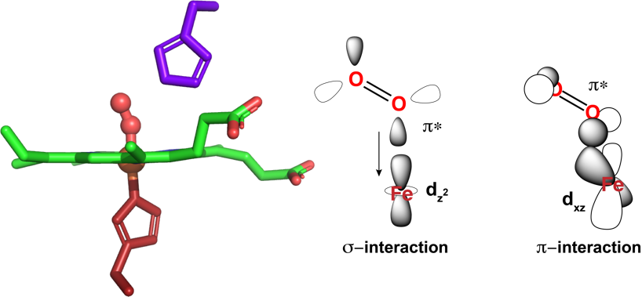
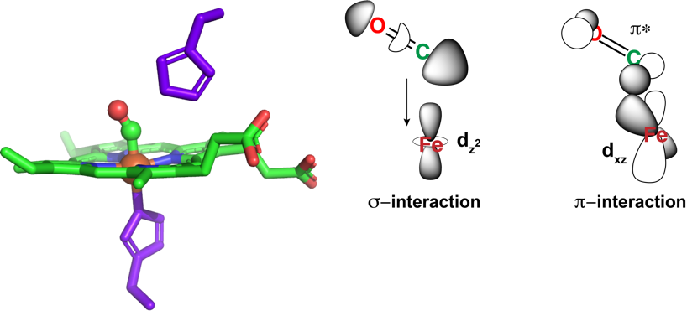
CH-105 INORGANIC TUTORIAL -III
Topic-V
Q-V.3. Why the Hemoglobin (Hb) preferably binds O₂ over CO despite better p-back-bonding properties of CO?
The binding pocket of Hemoglobin (Hb) (i.e. the axial site trans to the proximal histidine) contains a distal histidine ligand.
The presence of this distal histidine hinders any linear binding for the incoming sixth ligand to the heme-binding pocket and compels a bent binding mode. Such a bent binding mode favours the σ-interaction between heme Fe and O₂ (via its p* orbital)
However, the same is not true for CO molecule, where the extent of overlap between heme Fe and CO (via its σ-symmetric HOMO) is severely hampered.

